Slide 1
Feature Importances using Shapley Values
Noah Hirst-Ashuach

Slide 2
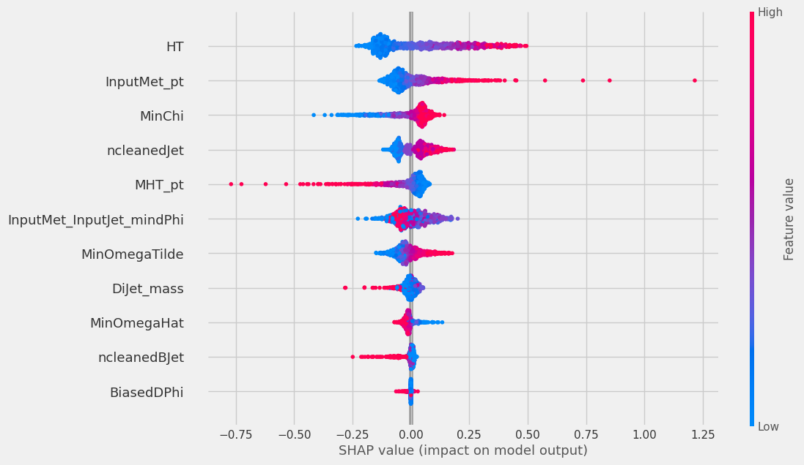
Violin plot
I used the SHAP module to calculate the Shapley values for each feature
Figure shows SHAP values for 1000 samples from my test set, coloured by feature value
Positive SHAP value means it suggests a signal, negative means it suggests a background

Slide 3
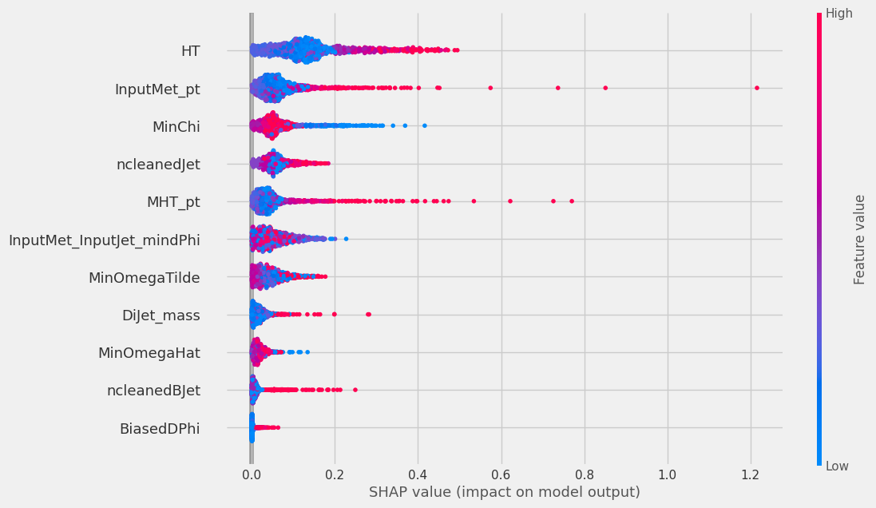
Absolute SHAP values

Slide 4
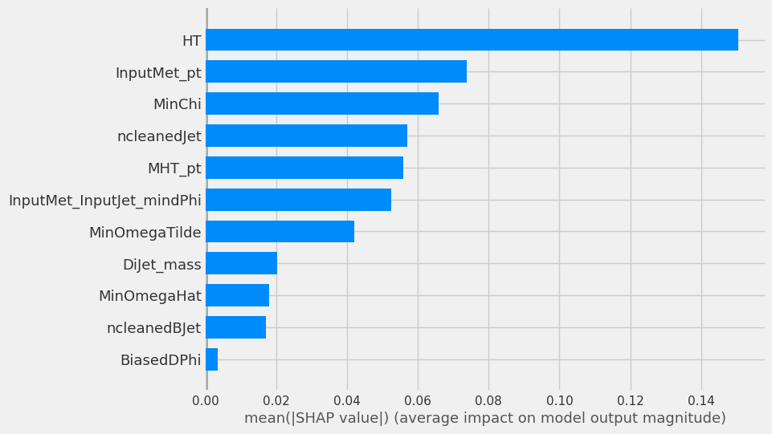
Mean SHAP values

Slide 5
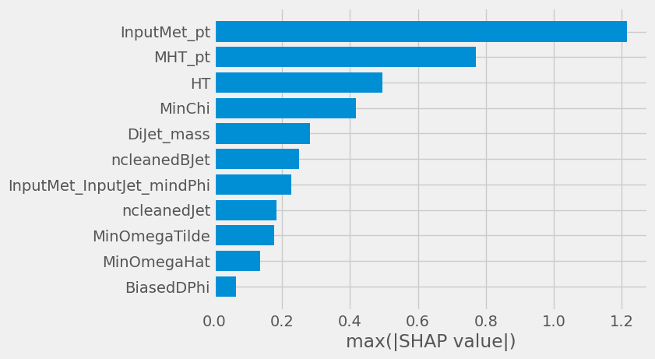
Max SHAP values

Slide 6
